Slide 1
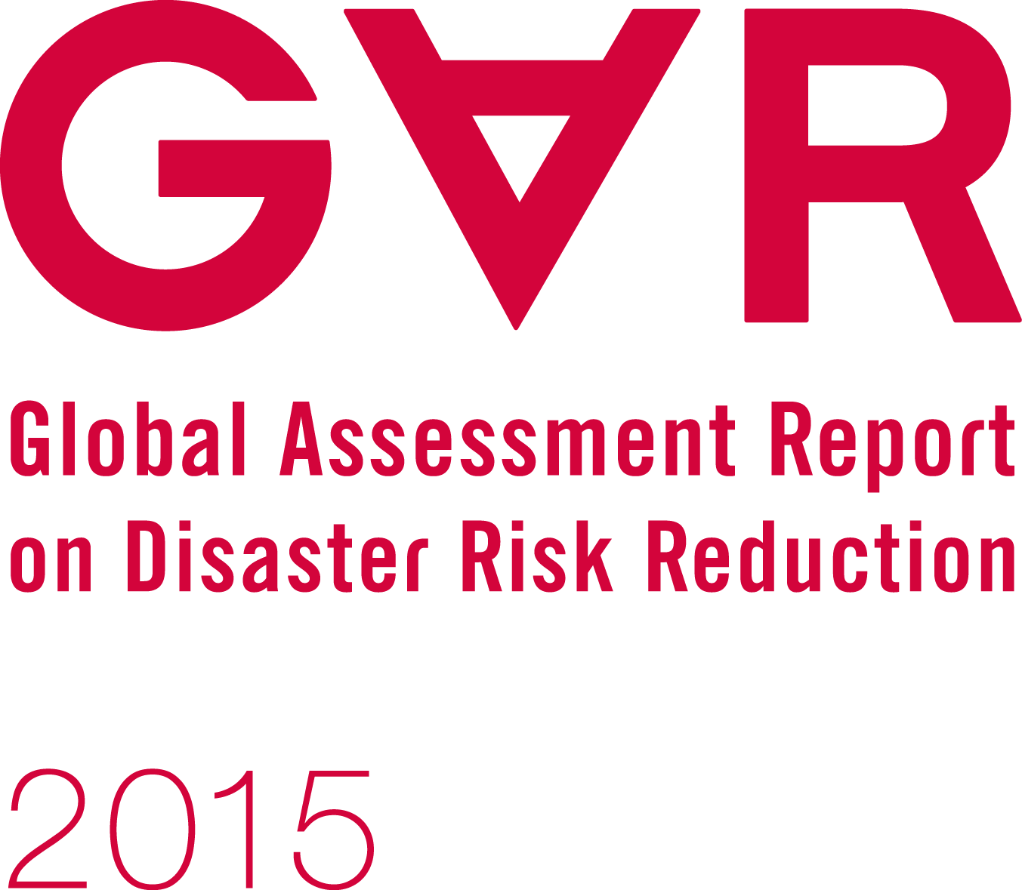
Making development sustainable: the future of disaster risk management
Notes:
FOURTH GAR SINCE 2007

Slide 2
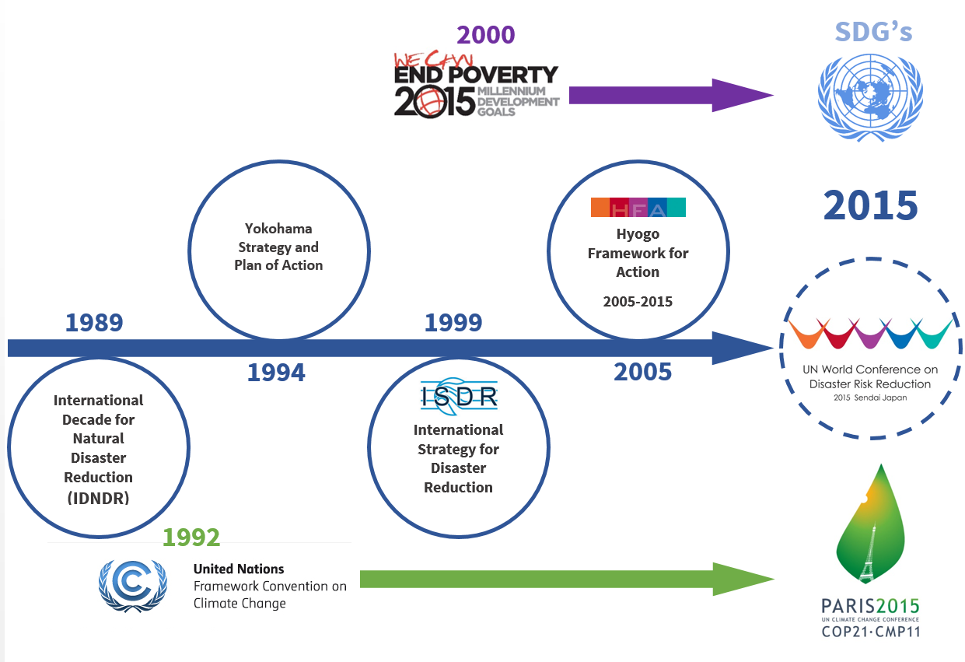
25 years of international commitment to disaster risk reduction
Notes:
25 YEARS OF INTERNATIONAL AGREEMENTS
HFA MONITOR AND GAR ONLY SINCE 2007
THREE INTERNATIONAL AGREEMENTS IN 2015
IS THE APPROACH TO DISASTER RISK MANAGEMENT FOLLOWED SINCE 1990 FIT FOR PURPOSE TO REDUCE DISASTER RISK AND TO FACILITATE SUSTAINABLE DEVELOPMENT

Slide 3
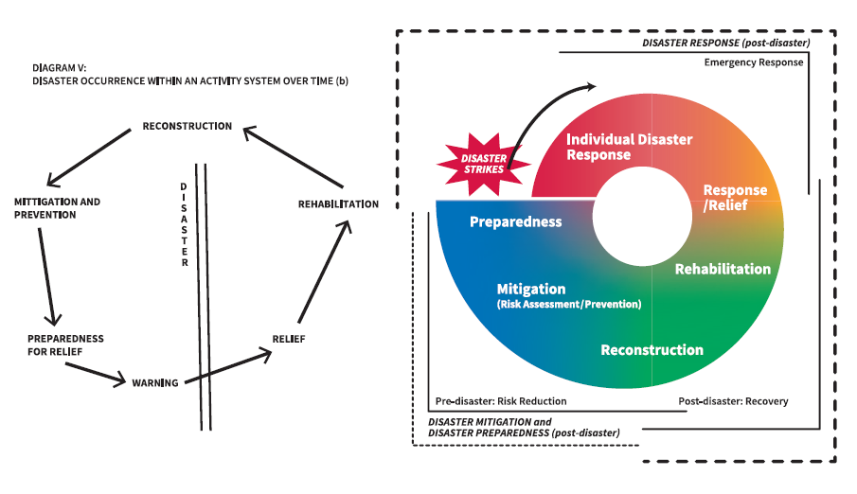
From managing disasters ………
1975
2011
Disaster management cycle
Notes:
EMERGENCY MANAGEMENT EVOLVED INTO DISASTER RISK MANAGEMENT ON THE BASIS OF THE DISASTER MANAGEMENT CYCLE
SYNCRETIC EVOLUTION FROM RESPONSE TO INCLUDE PREPAREDNESS, RECOVERY, RISK REDUCTION
INCREASED COMMITMENT UNDER HFA
PROTECT DEVELOPMENT AGAINST DISASTERS (AS EXOGENOUS EVENTS)
SECTOR HAS EVOLVED IN SOMETHING OF A SILO

Slide 4
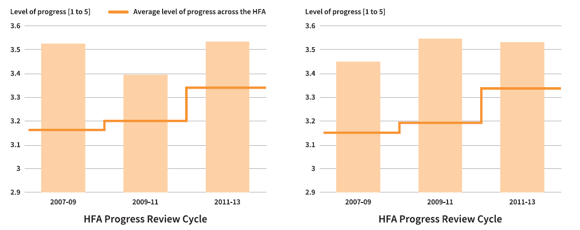
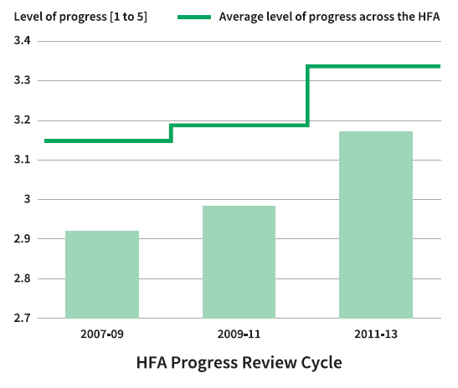
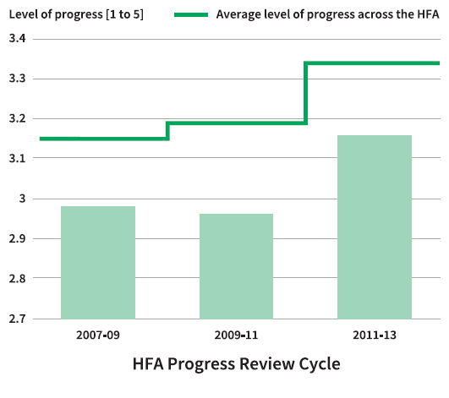
Less progress in managing risks
Strong policy, technical and institutional capacities and mechanisms
Disaster preparedness and contingency plans, training drills
Managing risk in urban environments
Assessing disaster risk impacts of major development projects
Notes:
HOWEVER RISK IS A DEPENDENT VARIABLE: FUNCTION OF EXPOSURE, HAZARD AND VULNERABILITY – IN TURN CONFIGURED BY DEVELOPMENT. RISK HAS NO SUBSTANTIAL, INDEPENDENT EXISTENCE, MORE LIKE A COLOUR OR TEXTURE OF DEVELOPMENT
HFA GAVE DETAILED GUIDANCE AND SPACE FOR MANAGING UNDERLYING RISKS IN DEVELOPMENT BUT THIS IS THE SPACE DRM SECTOR HAS NOT FILLED OR BEEN ABLE TO TO FILL
SCHIZOPHRENIC APPROACH TO DRR– PROTECTING DEVELOPMENT AGAINST ITSELF
RISKS HAVE INCREASED FASTER THAN THEY HAVE BEEN REDUCED

Slide 5
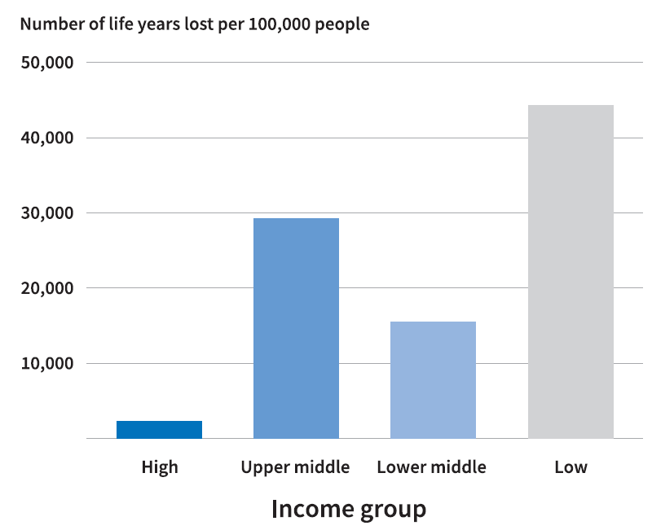
Revealing the real magnitude of risk
Life year lost:
Disasters: 42,000,000 (average 1990-2012) Tuberculosis: 43,000,000 (2012)
Malaria: 55,000,000 (2012)
Traffic accidents: 78,000,000 (2012)
Notes:
AFTER 25 YEARS OF INTERNATIONAL AGREEMENTS WE HAVE ACCUMULATED A HUGE STOCK OF RISKY DEVELOPMENT
THE FACT THAT MORTALITY AND ECOMONIC LOSS ARE COUNTED SEPARATELY MEANS THAT THE REAL DIMENSION OF THE PROBLEM IS RARELY VISIBLE (65 K DEATHS A YEAR VS 1 MILLION FROM TUBERCULOSIS, USD300 BILLION VS USD 4 TRILLION IN BANKING SECTOR IN 2008)
DISASTERS ARE MANIFEST RISK. CONVERTING LOSS INTO DALY GIVES ANA AVERAGE OF 42 MILLION LIFE YEARS PER YEAR. SIMILAR TO TUBERCULOSIS
80 PERCENT PLUS IN LOW AND MIDDLE INCOME COUNTRIES

Slide 6
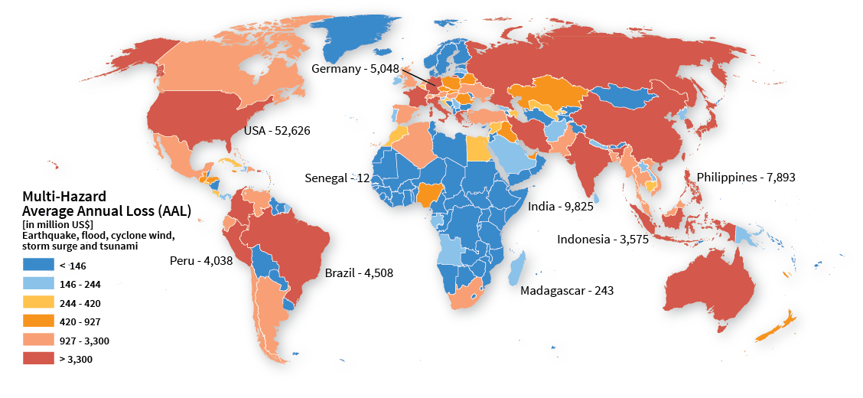
A risky world
Expected future disaster losses annualized over the long term
Notes:
HISTORICAL LOSS DOES NOT GIVE GOOD IDEA OF FUTURE RISK. MOST DISASTERS THAT COULD HAPPEN HAVE NOT HAPPENED YET
USD 314 BILLION PER YEAR AAL (EXCLUDES DROUGHT, AGRICULTURE, EXTENSIVE RISK)
AAL IS NOT WHAT COUNTRIES WILL LOSE EACH YEAR – WHAT THEY SHOULD SET ASIDE TO COVER future LOSSES OVER THE LONG TERM
USD 70 PER WORKING AGE PERSON OR 2 MONTHS INCOME FOR SOMEONE BELOW THE POVERTY LINE

Slide 7
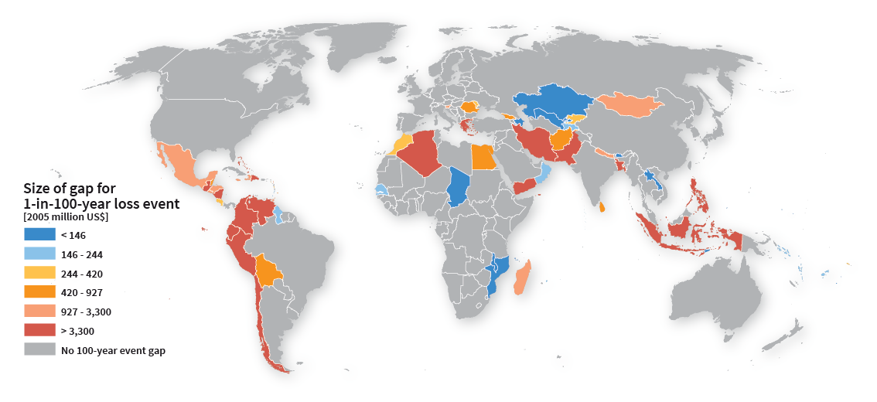
Fiscal resilience challenged
5% probability in 5 years of exceeding a loss
~
Flood Hazard - forthcoming
Potential financing gaps for a 1 in 100 year loss
Notes:
THE AAL ALSO DOES NOT INDICATE THE MAXIMUM LOSSES A COUNTRY COULD FACE.
COUNTRIES WITH BUDGET DEFICITS, INSUFFICIENT RESERVES ETC. MAY NOT BE ABLE TO ABSORB THIS KIND OF LOSS
STRESS TEST OF 1 IN 100 YEAR LOSS - 5% PROBABILITY IN 5 YEARS
NOT A PROBLEM FOR USA, CANADA, MOST OF EUROPE (EXCL. GREECE)
COUNTRIES LIKE MADAGASCAR, PAKISTAN, NICARAGUA WOULD FACE A MAJOR FINANCING GAP

Slide 8
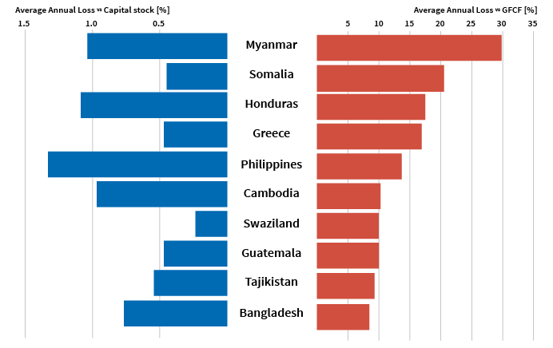
An opportunity cost for development
The risk to social progress, stability and economic development
Notes:
COUNTRIES WITH HIGH RATIO OF AAL TO SOCIAL EXPENDITURE, CAPITAL INVESTMENT AND CAPITAL STOCK WILL HAVE DIFFICULTIES TO ACHIEVE SUSTAINABLE DEVELOPMENT GOALS
For example, annual social expenditure is about 400 times greater in high-income countries than in low-income countries. However, expected annual losses in low-income countries are five times higher than in high-income countries expressed as a proportion of social expenditure.
IMPLICATIONS DIFFERENT: GREECE VS. CAPITAL STOCK AND CAPITAL INVESTMENT – MADAGASCAR SOCIAL EXPENDITURE
IMPLICATIONS FOR GREECE SIMILAR TO PHILIPPINES AND HONDURAS EVEN THOUGH RISK IS RELATIVELY LOWER

Slide 9
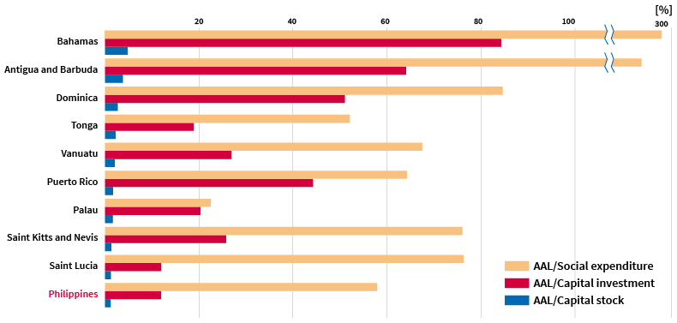
SIDS: an existential threat
Average annual loss as a proportion of social expenditure, capital investment and capital stock: top 15 countries
Notes:
SIDS: AAL EQUIVALENT TO:
20 TIMES MORE OF THEIR CAPITAL STOCK COMPARED TO EUROPE
20 TIMES MORE OF THEIR SOCIAL EXPENDITURE COMPARED TO EUROPE
8 TIMES MORE OF THEIR INVESTMENT THAN EUROPE
SOME BIGGER COUNTRIES LIKE PHILIPPINES AND MADAGASCAR HAVE SIMILAR ISSUES PARTICULARLY WITH RESPECT TO SOCIAL EXPENDITURE
THREATENS THEIR CAPACITY FOR SUSTAINABLE DEVELOPMENT

Slide 10
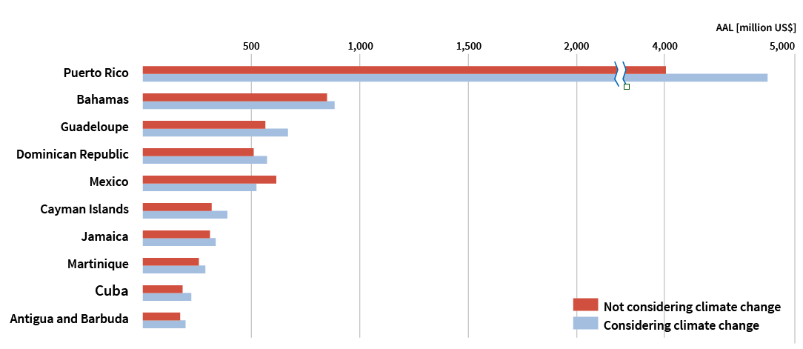
Climate change magnifies risk
Total increase of AAL with climate change to 2050 = US$ 1.4 billion
The increase in annual average loss due to wind damage in the Caribbean by 2050 as a result of climate change
Notes:
CLIMATE CHANGE ADDS USD 1.4 BILLION TO WIND DAMAGE AAL IN CARIBBEAN BY 2050
IN SOME COUNTRIES (T & T) LARGE INCREASE, OTHERS (MEXICO) DECREASE
SIMILARLY AGRICULTURAL DROUGHT RISK IN AFRICA: UP IN MALAWI, DOWN IN KENYA AND NIGER

Slide 11
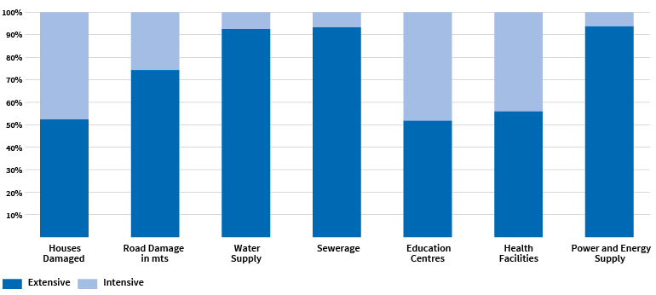
Extensive risk: eroding resilience
Most disaster impacts in infrastructure are associated with extensive risk
Notes:
EXTENSIVE RISK: DATA FROM 85 COUNTRIES AND 2 STATES
OVER 50 PERCENT OF DAMAGE TO LOCAL INFRASTRUCTURE (DOESN’T INCLUDE PORTS, AIRPORTS, POWER STATIONS AND ELEMENTS OF CAPITAL INTENSIVE INFRASTRUCTURE)
LOW-INCOME HOUSEHOLDS, SMALL BUSINESSES, LOCAL GOVERNMENTS
INSIDE POVERTY – A POVERTY ATTRIBUTE
Extensive risk is responsible for most disaster morbidity and displacement, and it represents an ongoing erosion of development assets, such as houses, schools, health facilities, roads and local infrastructure, particularly in low and middle-income countries.
Data on extensive risks is now available from 85 countries and territories (up from 12 in 2009). In the last decade, losses due to extensive risk in these countries and territories were equivalent to a total of US$94 billion.
The cost of extensive risk is usually absorbed by the low-income households and communities and small businesses that depend on public infrastructure and the local governments that provide it., becoming an important poverty attribute in the process.

Slide 12
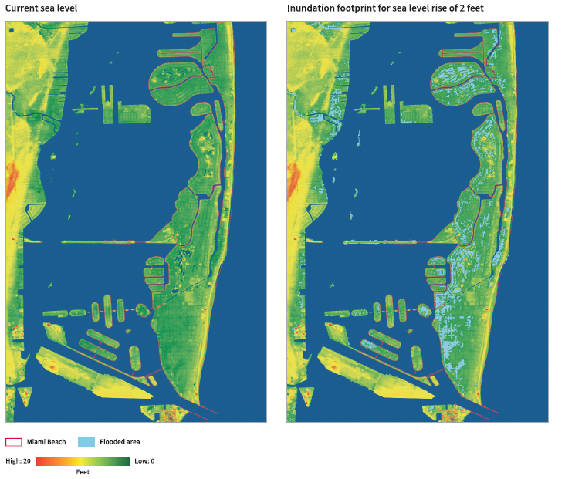
Underlying risk drivers: Mispricing risk
Estimated impact of sea level rise in Miami Beach by 2060
Notes:
RISK THE FUTURE
FOUR DRIVERS THAT CHARACTERISE OUR CURRENT DEVELOPMENT PARADIGM
ALL INTERLINKED :
FIRST IS THAT RISK IS MISPRICED
IN A GLOBALISED ECONOMY investment tends to flow to locations that offer comparative advantages, including low labour costs, access to export markets, infrastructure, stability and other factors. HAZARD RARELY CONSIDERED
SHORT TERM PROFITS OUTWEIGH FUTURE SUSTAINABILITY
MIAMI BEACH IS A CASE IN POINT
INCREASING HAZARD EXPOSURE AND SYSTEMIC RISK

Slide 13
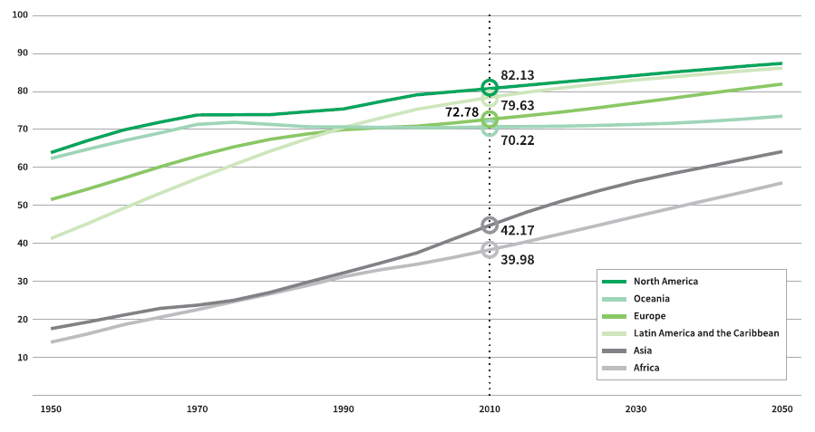
Underlying risk drivers: Urbanizing risk
Expected regional increase in the proportion of urban population by 2050
Notes:
RISK IS DRIVEN BY UNEQUAL ACCESS TO URBAN SPACE, INFRASTRUCTURE, SERVICES AND SECURITY.
ABSOLUTE NUMBERS LIVING IN SQUATTER SETTLEMENTS CONTINUE TO RISE
60 PERCENT OF AREA TO BE URBANISED BY 2030 REMAINS TO BE BUILT
MOST URBAN GROWTH IN AFRICA AND SOUTH ASIA, PARTICULARLY IN SMALLER URBAN CENTRES
THESE ARE WHERE LOCAL GOVERNMENTS DO NOT HAVE THE CAPACITIES TO PLAN AND MANAGE DEVELOPMENT

Slide 14
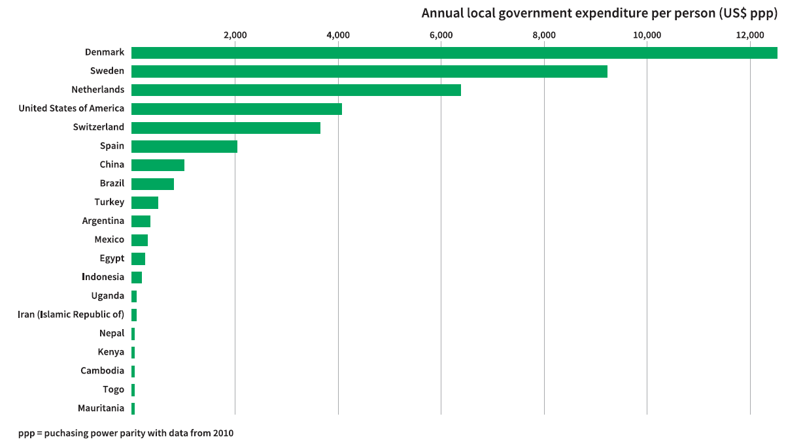
Underlying risk drivers: Growing inequalities
Annual local government spending per person for selected countries
Notes:
WORLD IS BECOMING A MORE UNEQUAL PLACE
GLOBAL GINI COEFFICIENT OF 0.89 NEARING ABSOLUTE INEQUALITY
1 PERCENT OWN 48% OF WEALTH (CREDIT SUISSE)
ALL GAR HAVE SHOWN HOW RISK IS DISPROPORTIONATELY CONCENTRATED IN LOW INCOME HOUSEHOLDS AND COMMUNITIES IN LOW INCOME COUNTRIES
THEREFORE IF INEQUALITY CONTINUES TO INCREASE, SO WILL RISK IN THE REGIONS AND SECTORS LEFT BEHIND
UNIVERSALITY OF HFA CHALLENGED BY CAPACITIES FOR LOCAL IMPLEMENTATION - LOCAL GOVT. SPENDING RANGES FROM USD12K PER CAPITA IN DENMARK TO USD4 IN PARTS OF SUB-SAHARAN AFRICA
LOW LEVELS OF INVESTMENT IN RISK REDUCING INFRASTRUCTURE, SOCIAL AND ENVIRONMENTAL PROTECTION ETC.

Slide 15
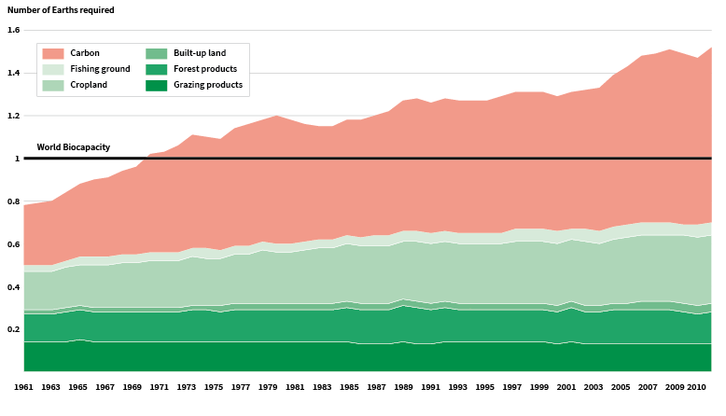
Underlying risk drivers: Overconsumption overwhelming bio-capacity
About 1.5 planets are now required to sustain current levels of consumption
Notes:
CLIMATE CHANGE AND DESTRUCTION OF ECOSYSTEMS INCREASES RISKS
52 PERCENT OF COASTAL WETLANDS LOST SINCE 1980. RAPID DEGRDATION OF CORAL REEFS AND MANGGROVES
CLIMATE CHANGE …. 350 PPM TO 400 PPM
WE WOULD CURRENTLY NEED 1.5 PLANETS TO COPE WITH WHAT WE ARE TAKING OUT AND WASTE WE ARE PUTTING BACK IN
CAN ONLY GET WORSE ……. ESTIAMTES THAT BY 2050 40 PERCENT OF THE GLOBAL POPULATION WILL LIVE IN RIVER BASINS WITH SEVERE WATER STRESS

Slide 16
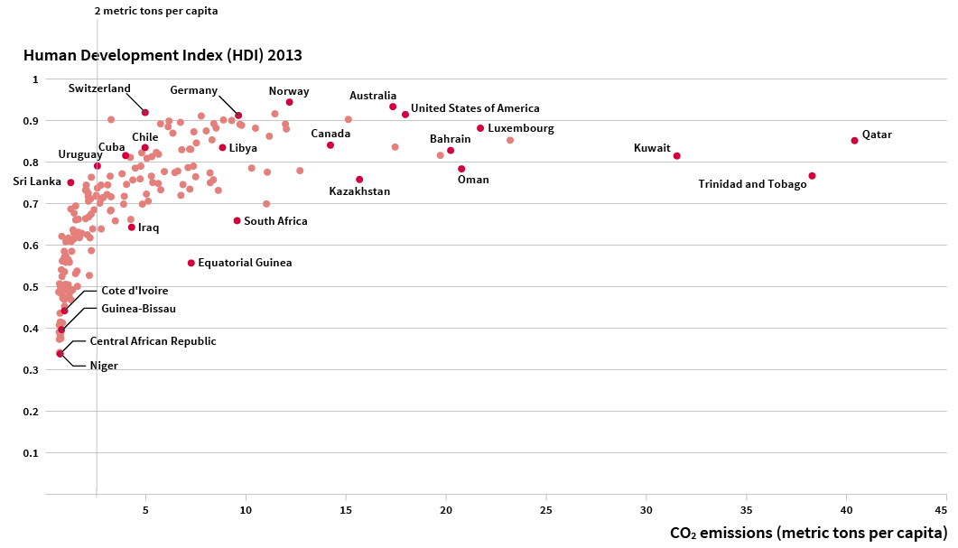
Developing sustainably is possible
The non-linear relationship between energy consumption and human development
Notes:
IF WE ARE TO REDUCE RISK WE WILL HAVE TO DEVELOPMENT IN A DIFFERENT WAY: LOW CARBON ECONOMY … MITIGATES CLIMATE CHANGE, RESTORING REGULATORY ECOSYSTEMS ….. LESS FLOODS AND STORM SURGE HAZARD, SUSTAINABLE AGRICULTURE … MORE FOOD SECURITY…
FORTUNTELY DEVELOPING SUSTIANABLY IT IS POSSIBLE
HUMAN DEVELOPMENT AND SOCIAL PROGRESS DO NOT DEPEND ON INLIMITED INCREASES IN ENERGY CONSUMPTION OR GDP
AND IS HAPPENING: GROWING MOMENTUM OF CHANGING DEVELOPMENT PRACTICES IN RENEWABLE ENERGY, WASTE AND WATER MANAGEMENT, ECOSYSTEM ENHANCEMENT, GREEN INFRASTRUCTURE, SUSTAINABLE AGRICULTURE ETC.
INITIATIVES FROM CITIZENS, CITIES, BUSINESSES
MOMENTUM NOW IN LOW AND MIDDLE INCOME COUNTRIES

Slide 17
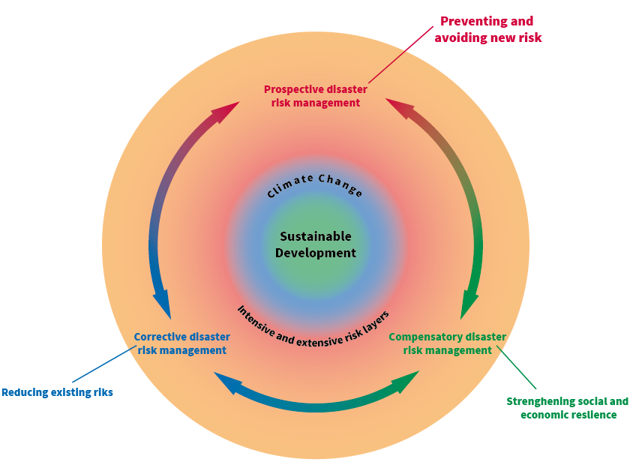
From managing disasters to managing risks
Managing risks aligns the disaster risk reduction, climate change action and sustainable development agendas
Notes:
BUT TO FACILTIATE DEVELOPING SUSTINABLY MEANS THAT WE HAVE TO CHANGE OUR APPROACH TO DRM: THE FOCUS HAS TO MORE FROM MANAGING DISASTERS (PROTECTING OLD DEVELOPMENT PARADIGM AGAINST EXTERNAL THREATS) TO MANAGING RISKS INSIDE DEVELOPMENT
DISASTER RISK AND CLIMATE CHANGE ARE BOTH DEPENDENT VARIABLES OF DEVELOPMENT. THEREFORE RISK MANAGEMENT CUTS ACROSS AND ALIGNS ALL THREE FRAMEWORKS UNDER DISCUSSION
RISK MANAGEMENT NOW HAS TO BECOME NOT AN ADD-ON THAT NEEDS TO BE MAINSTREAMED INTO DEVELOPMENT BUT A SET OF PRACTICES EMBEDDED IN ITS VERY DNA
THREE APPROACHES TO DRM: PREVENTING AND AVOIDING NEW RISK, REDUCING EXISTING RISKS, STRENGTHENING SOCIAL AND ECONOMIC RESILIENCE NEED TO BE COMBINED IN APPROPRIATE STRATEGIES

Slide 18
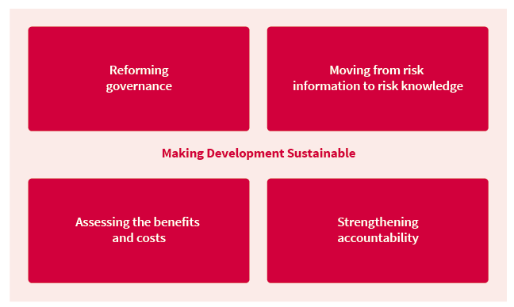
The future of disaster risk management
Innovations in areas as diverse as risk governance, risk knowledge, benefit-cost analysis and accountability are challenging old assumptions and creating new opportunities.
Notes:
FORTUNTELY DRM ITSELF IS RAPIDLY EVOLVING
INNOVATION COMING FROM CITIES, PRIVATE AND FINANCIAL SECTOR, CIVIL SOCIETY AND FROM SOME GOVERNMENTS
GOVERNANCE INNOVATIONS: COUNTRIES WILL CONTINUE TO REQUIRED DM INSTITTUIONS BUT MANY ARE NOT EXPERIMENTING WITH NEW LEGISLATION AND INSTITUTIONS, LOCUS OF FINANCE AND PLANNING MINISTRIES ETC. CHIEF RISK OFFICERS
NEW OPEN ACCESS RISK METRICS COMING ON STREAM: HELP TO REPRICE RISK. EXTENSIVE RISK AND SOCIAL DEMAND
BENEFIT COST ANALYSIS STARTING TO OPEN UP: FROM REPLACEMENT COSTS TO DOWNSTREAM BENEFITS
ACCOUNTABILITY: FROM DISASTERS TO RISKS. PARLIAMENTARY COMMITTEES, NATIONAL AUDIT BODIES, RISK OMBUDSMAN, VOLUNTARY STANDARDS ETC.

Slide 19
Thank you
#gar15

